Slide 1

Coding Dojo 7
Kata Incomprehensible Finder
TDD

Slide 2
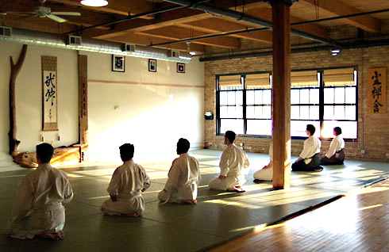

Antes de empezar (Introducción)
Lugar donde nos reunimos para practicar y entrenar buenas formas de programación.
Lugar donde se reúne la gente para practicar y entrenar artes marciales.

Slide 3
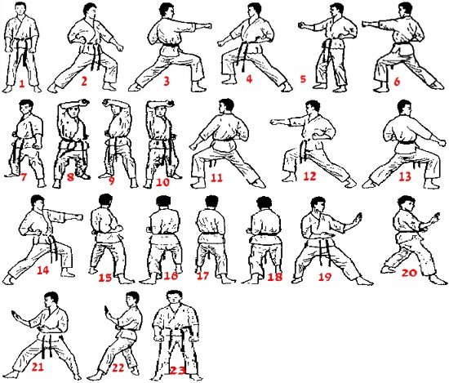
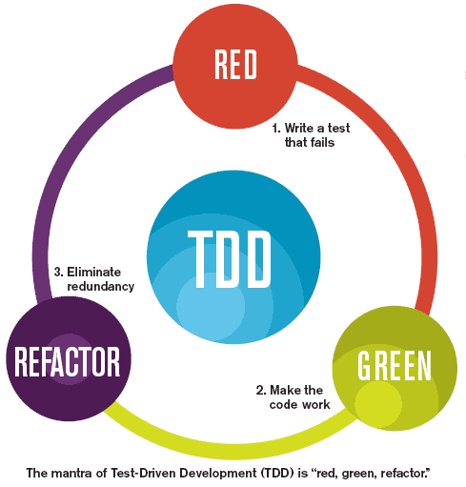
Antes de empezar (Introducción)
Ejecutan Katas para aprender los movimientos y las técnicas.
Usamos TDD
Desarrollamos por consenso

Slide 4
Antes de empezar (Refactor)
“Cambios en el código para hacerlo más fácil de entender y más barato de modificar, sin alterar su comportamiento observable”
- Martin Fowler -

Slide 5
Antes de empezar (Refactor)
Basic smells
Design smells
COMMENTS
MAGIC NUMBER
LONG METHOD
DUPLICATE METHOD
LARGE CLASS
LONG PARAMETER LIST
SWITCHS
PRIMITIVE OBSESSION
MESSAGE CHAINS
SPECULATIVE GENERALIZATION
DATA CLUMPS
FEATURE ENVY
https://refactoring.guru/refactoring/smells

Slide 6
Práctica
Kata Incomprehensible Finder

Slide 7
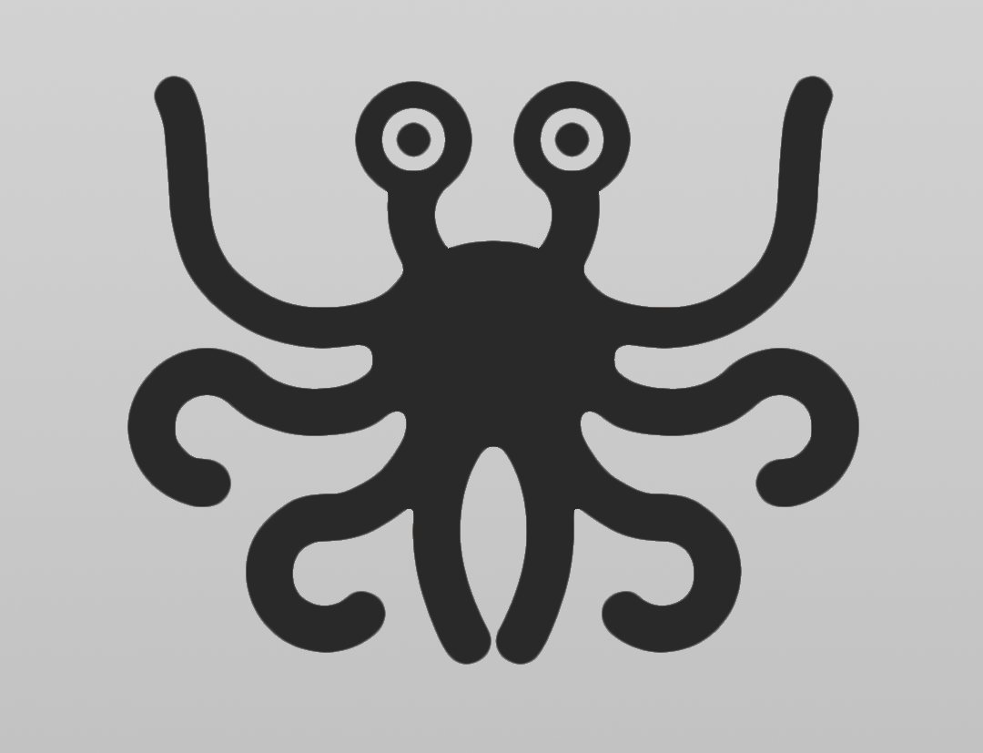
Incomprehensible Finder (Enunciado)
Here is the bad news: the new developer you hired has written some terrible, atrocious code. No one can understand what it does.
The good news: at least there are unit tests to prove the code is working.
You job is to refactor the code and make it readable, while keeping the code in working order (pass all tests).

Slide 8
Incomprehensible Finder (Enunciado)
Tips:
Start with simple rename refactors so you can better understand the abstractions you are working with. Rename any class or any variable.
Move on to extract methods and making the code more modular.
See if you can also eliminate switch statements and multiple exit points from methods.
Anything is fair game, create new classes, new methods, and rename tests. The only restriction is that the existing tests have to keep working. Lean on the tests and run them after every small change to make sure you are on the right path.
You can stop when you feel the code is good enough, something you can come back to in 6 months and understand.
Basada en la kata Incomprehensible Finder: https://github.com/DoDevJutsu/incomprehensible-finder-refactoring-java

Slide 9


